Slide 1
Classroom slides - Intro

Slide 2
Application (Algorithms expressed in High Level Language)
System software (Compiler, OS, etc.)
Computer Architecture
Machine Organization (Datapath and Control)
Sequential and Combinational Logic Elements
Logic Gates
Transistors
Solid-State Physics (Electrons and Holes)

Slide 3
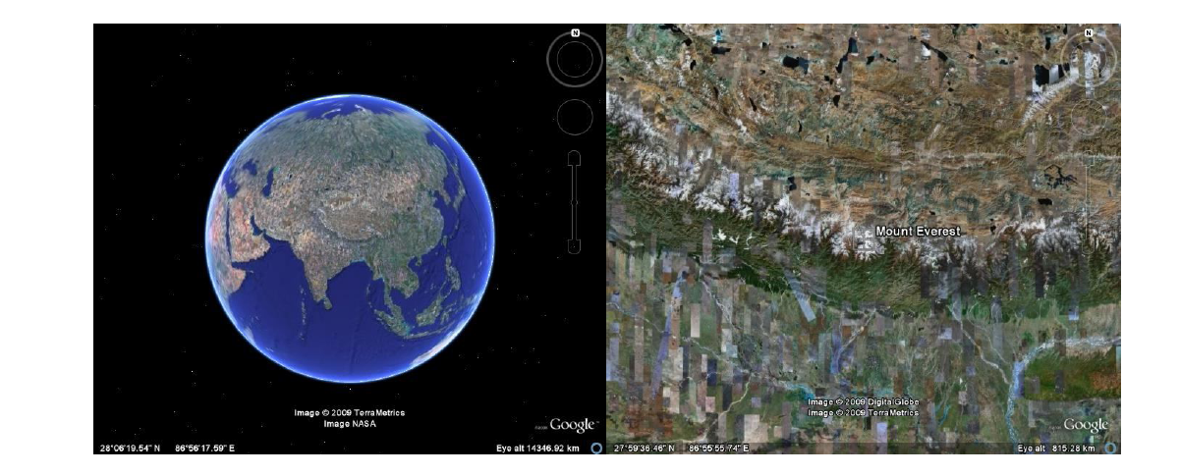

Slide 4
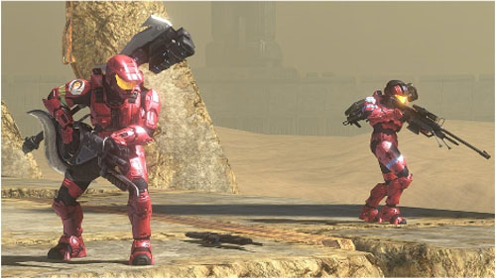
Levels of Abstraction

Slide 5
Video Game
Compiler
Instruction-Set
Datapath and Control
Video and Audio
Content
HLL Source
Program
Logic Elements
Gates
Transistors
Electrons and Holes
Hardware
Software

Slide 6


Networked
Video Game
Compiler
compiler
analysis
synthesis
Instruction
Set
swap ld r1 r2
add r3 r6 r7
sub r5 r4 r3
jsr mult
Datapath &
Control
Control
Datapath
Logic
Elements
Decoder
Mux
Gates
Transistors
+
+
+
+
+
+
+
Electrons &
Holes
-
-
-
-
-
-

Slide 7
The Role of the Operating System?
Resource manager
Provide consistent interface to resources
Job scheduler

Slide 8
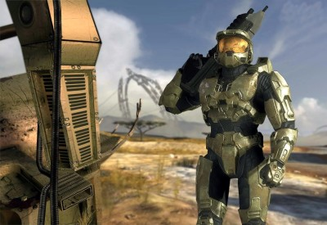

Client Application
(Halo 3)
Player clicks mouse
cursor on target

Slide 9
Client Application
(Halo 3)
Player clicks mouse
cursor on target
OS: Recognizes interrupt
Sends it to client application
It's a mouse interrupt!

Slide 10
Client Application
(Halo 3)
Player clicks mouse
cursor on target
OS: Recognizes interrupt
Sends it to client application
It's a mouse interrupt!
CLIENT

Slide 11

Client Application
(Halo 3)
Player clicks mouse
cursor on target
OS: Recognizes interrupt
Sends it to client application
It's a mouse interrupt!
CLIENT
Client Application creates
message to send to server
application

Slide 12

Client Application
(Halo 3)
Player clicks mouse
cursor on target
OS: Recognizes interrupt
Sends it to client application
It's a mouse interrupt!
CLIENT
Client Application creates
message to send to server
application
OS: Sends
Message to
server

Slide 13
Client Application
(Halo 3)
Player clicks mouse
cursor on target
OS: Recognizes interrupt
Sends it to client application
It's a mouse interrupt!
CLIENT
Client Application creates
message to send to server
application
SERVER
OS: Sends
Message to
server
Got a message!
OS: Receives
Message sends
to server application

Slide 14
Client Application
(Halo 3)
Player clicks mouse
cursor on target
OS: Recognizes interrupt
Sends it to client application
It's a mouse interrupt!
CLIENT
Client Application creates
message to send to server
application
SERVER
OS: Sends
Message to
server
Application examines
message and state of
game and determines
Master Chief dies! Sends
message back to client.
Got a message!
OS: Receives
Message sends
to server application

Slide 15
Client Application
(Halo 3)
Player clicks mouse
cursor on target
OS: Recognizes interrupt
Sends it to client application
It's a mouse interrupt!
CLIENT
Client Application creates
message to send to server
application
SERVER
OS: Sends
Message to
server
Application examines
message and state of
game and determines
Master Chief dies! Sends
message back to client.
Got a message!
OS: Receives
Message sends
to server application
OS: Sends
Message to client

Slide 16
Client Application
(Halo 3)
Player clicks mouse
cursor on target
OS: Recognizes interrupt
Sends it to client application
It's a mouse interrupt!
CLIENT
Client Application creates
message to send to server
application
SERVER
OS: Sends
Message to
server
OS: Receives
message and
sends it to
application
Application examines
message and state of
game and determines
Master Chief dies! Sends
message back to client.
Got a message!
OS: Receives
Message sends
to server application
OS: Sends
Message to client

Slide 17
Client Application
(Halo 3)
Player clicks mouse
cursor on target
OS: Recognizes interrupt
Sends it to client application
It's a mouse interrupt!
CLIENT
Client Application creates
message to send to server
application
ClientApplication generates
required images, etc.
Sends I/O requests to OS
SERVER
OS: Sends
Message to
server
OS: Receives
message and
sends it to
application
Application examines
message and state of
game and determines
Master Chief dies! Sends
message back to client.
Got a message!
OS: Receives
Message sends
to server application
OS: Sends
Message to client

Slide 18
Client Application
(Halo 3)
Player clicks mouse
cursor on target
OS: Recognizes interrupt
Sends it to client application
OS changes I/O devices to
show Master Chief blowing
up!!!
It's a mouse interrupt!
CLIENT
ut oh!
Client Application creates
message to send to server
application
ClientApplication generates
required images, etc.
Sends I/O requests to OS
SERVER
OS: Sends
Message to
server
OS: Receives
message and
sends it to
application
Application examines
message and state of
game and determines
Master Chief dies! Sends
message back to client.
Got a message!
OS: Receives
Message sends
to server application
OS: Sends
Message to client

Slide 19
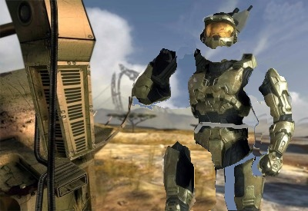
Client Application
(Halo 3)
BAM!!!
Player clicks mouse
cursor on target
OS: Recognizes interrupt
Sends it to client application
OS changes I/O devices to
show Master Chief blowing
up!!!
It's a mouse interrupt!
CLIENT
ut oh!
Client Application creates
message to send to server
application
ClientApplication generates
required images, etc.
Sends I/O requests to OS
SERVER
OS: Sends
Message to
server
OS: Receives
message and
sends it to
application
Application examines
message and state of
game and determines
Master Chief dies! Sends
message back to client.
Got a message!
OS: Receives
Message sends
to server application
OS: Sends
Message to client

Slide 20
Client Application
(Halo 3)
BAM!!!
Player clicks mouse
cursor on target
OS: Recognizes interrupt
Sends it to client application
OS changes I/O devices to
show Master Chief blowing
up!!!
It's a mouse interrupt!
CLIENT
ut oh!
Client Application creates
message to send to server
application
ClientApplication generates
required images, etc.
Sends I/O requests to OS
SERVER
OS: Sends
Message to
server
OS: Receives
message and
sends it to
application
Application examines
message and state of
game and determines
Master Chief dies! Sends
message back to client.
Got a message!
OS: Receives
Message sends
to server application
OS: Sends
Message to client

Slide 21
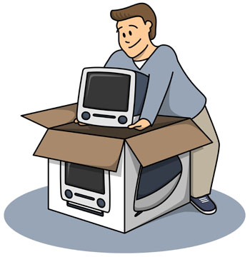
What’s Inside the Box?

Slide 22
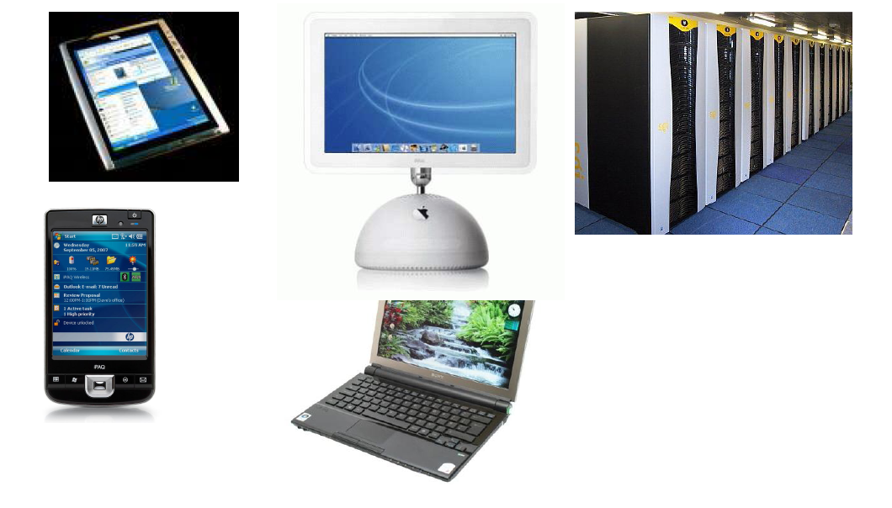

Slide 23
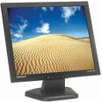



CPU
Graphics
controller
System bus
Bridge
I/O bus
Memory
Controller
Controller
Controller

Slide 24
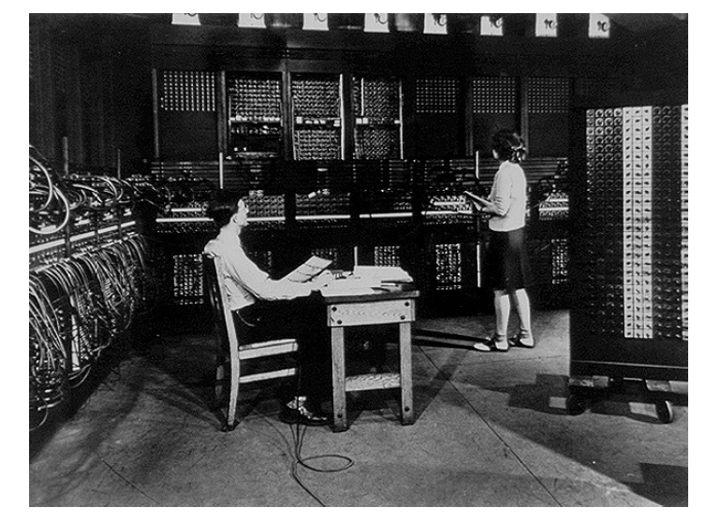
Architecture evolution

Slide 25
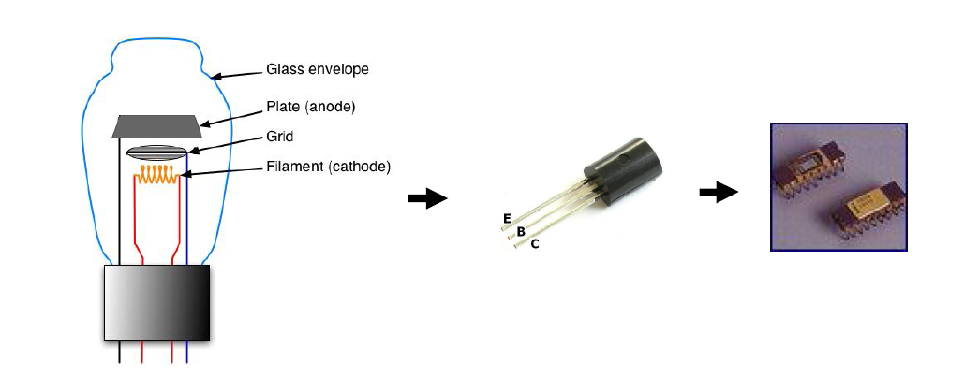
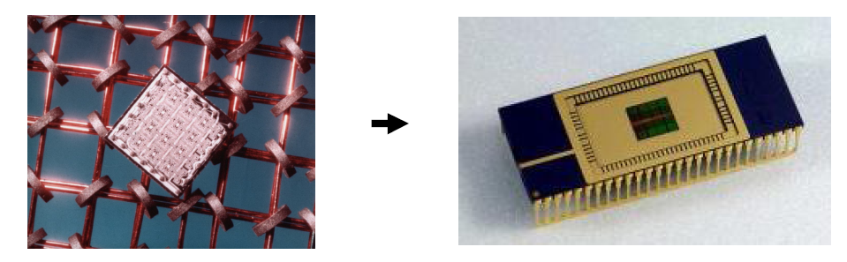

Slide 26
OS evolution
Mainframe, mini
  FMS -> batch -> timesharing
PC/Desktops
  GUI/Windows (Windows, MacOS)
Enterprise
  Linux
Handhelds
  Embedded OS (Symbian, Blackberry)
  Derivatives (Mac iPhone, Win CE)
Grid/Cloud computing

Slide 27
This course?
Processor
Memory
I/O
Parallelism
Networking

Slide 28
Fundamentals of Programming
Fundamentals of Digital Electronic & Logic Design
Integrated Approach to Computer Architecture and Operating Systems
Advanced Topics in Operating Systems
Advanced Topics in Computer Architecture
Advanced Topics in Computer Networks

